Slide 1



Secure Digital Banking Platform
with Transaction Management System
Infosys Internship Project
Submitted By:
Akshay Vardhan Devarakonda Ashlesha Patil
Karishma Chinthakunta
Rajdeep Kala
Mudyadam Soumya
Sowndarya Lakshmi S
Mentor: Suramya Biswas

Slide 2

Project Introduction
This project aims to develop a Secure Digital Banking Platform that enables customers to manage their finances safely and efficiently. The platform provides comprehensive account management, seamless transaction processing, and robust security — replacing manual banking processes with a modern, scalable web-based solution built for reliability and ease of use.

Slide 3

Problem Statement
Traditional banking processes rely heavily on manual operations, leading to inefficiencies, human errors, and security vulnerabilities. Customers face challenges with slow transaction processing, lack of real-time account visibility, and limited access to banking services. There is a critical need for a secure, scalable digital banking platform that enables safe authentication, seamless transaction management, and reliable data integrity for modern financial operations.

Slide 4

Objectives
Secure Authentication
Account Management
Deposit & Withdrawal
Fund Transfers
Transaction Tracking
Balance Monitoring
Scalable Web Interface
Data Security

Slide 5

System Architecture
React Frontend (Port 3737) → Spring Boot Backend (Port 9797) → MySQL Database
Presentation Layer: React + HTML/CSS/Bootstrap UI components and dashboards.
Business Logic Layer: Spring Boot REST APIs with Spring Security and Spring Data JPA.
Data Layer: MySQL relational database for accounts, transactions, and user data.
Request flow: User interacts with React UI → HTTP REST calls to Spring Boot → JPA/Hibernate queries MySQL → Response returned to frontend.

Slide 6
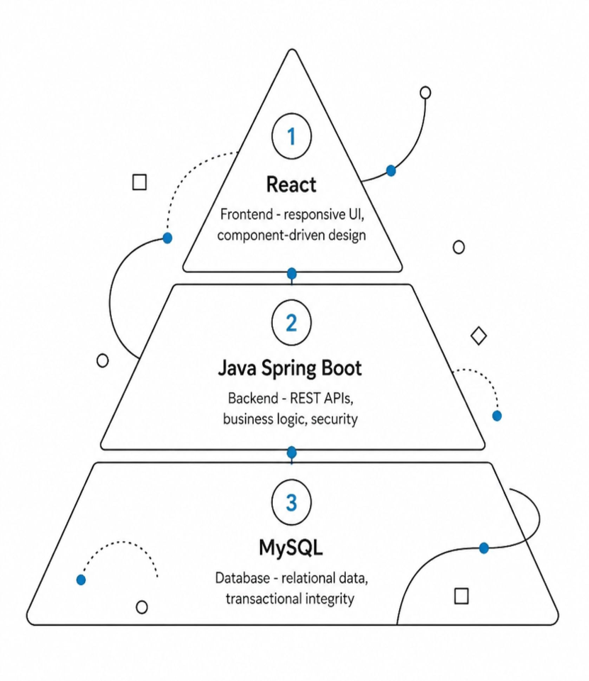
Technology Stack
Java 17
Spring Boot
Spring Web
Spring Security
Spring Data JPA
MySQL
React
HTML / CSS / Bootstrap
Maven

Slide 7

Main Modules
Customer/User Module: Manages user profiles, registration, and personal account details.
Account Module: Handles account creation, balance tracking, and account operations.
Transaction Module: Records and processes all financial transactions with full history.
Payments Module: Facilitates fund transfers and payment processing between accounts.
Loans Module: Manages loan applications, approvals, and repayment tracking.
Authentication & Security Module: Enforces secure login, authorization, and API access control.

Slide 8

Authentication & Security
Spring Security framework integrated for robust access control and API protection. Password encryption using BCrypt hashing ensures secure credential storage. Role-based authorization restricts access to sensitive banking operations. All REST API endpoints are secured with authentication filters. Session management and CSRF protection guard against common web vulnerabilities.

Slide 9

Account & Transaction Management
Core Operations: Customers can perform deposits, withdrawals, and fund transfers seamlessly. Each operation updates the account balance in real-time via secure REST API calls to the Spring Boot backend, with data persisted in MySQL through JPA/Hibernate.
Transaction History & Balance Tracking: Users can view complete transaction history with timestamps, types, and amounts. The dashboard displays current balance and a detailed ledger of all past transactions, ensuring full transparency and auditability.

Slide 10

Frontend & User Experience
The React-based frontend runs on port 3737, delivering a responsive and intuitive banking interface. Key UI components include an interactive dashboard with account summaries, smooth navigation menus, and structured forms for deposits, withdrawals, and transfers. Bootstrap ensures a clean, mobile-friendly layout, while HTML/CSS styling provides a professional look. Users can easily track balances and transaction histories through a seamless, user-centered design.

Slide 11



Backend & Database
The backend is built on Spring Boot running on port 9797, exposing RESTful APIs for all banking operations. Spring Data JPA with Hibernate handles ORM-based persistence, mapping Java entities to a MySQL relational database. REST endpoints manage accounts, transactions, and authentication, ensuring clean separation of concerns and scalable data access across the platform.

Slide 12
Future Enhancements
Planned Improvements:
• Loan management module with EMI calculation and approval workflows
• Payment gateway integration (Razorpay / Stripe) for real-time payments
• Email & SMS notifications for transactions and alerts
• Advanced analytics dashboard for spending insights
Scalability & Security:
• Stronger fraud detection using rule-based and ML-driven models
• Two-factor authentication (2FA) and enhanced session management
• Cloud deployment (AWS / Azure) with auto-scaling and CI/CD pipelines
• Performance optimization and comprehensive audit logging

Slide 13

Conclusion
The Secure Digital Banking Platform successfully delivers a robust, scalable solution for modern banking needs. Key achievements include secure user authentication, seamless account and transaction management, real-time deposit, withdrawal, and fund transfer capabilities, and a responsive React-based interface. The platform demonstrates effective integration of Spring Boot, Spring Security, and MySQL, providing a reliable foundation for future enhancements and real-world deployment.

Slide 14
Thank
You
Mentor: Suramya Biswas
Infosys Internship Project

